Slide 1
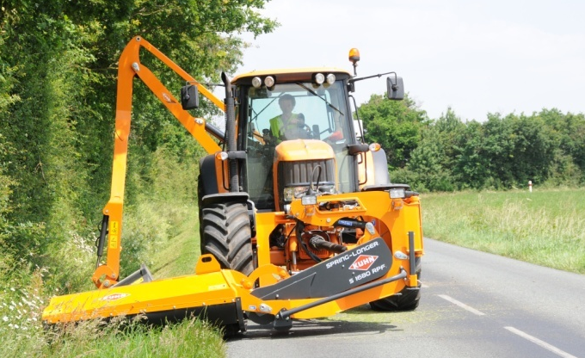
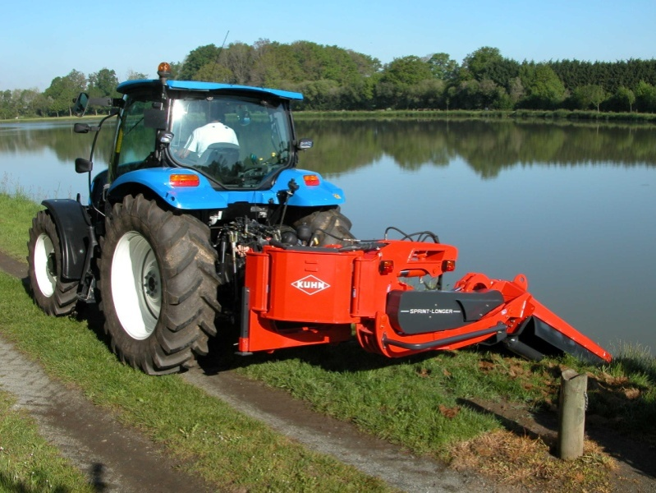
SPRING-LONGER

Slide 2
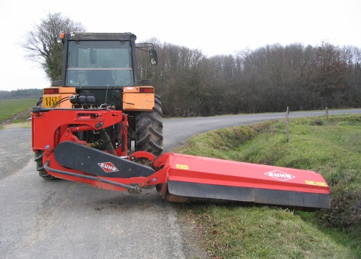
The SPRING-LONGER range
S 1680 RP
S 2080 RP
S 2380 RP
S 1680 RPF
S 2080 RPF
Models | S 1680 RP | S 1680 RPF | S 2080 RP | S 2080 RPF | S 2380 RP
Cutting width | 1.60 m |  | 2.00 m |  | 2,30 m
Horizontal reach | 3,50 m |  | 3,90m |  | 4,20 m
Controls | Circuit selector control
Kinematics | Integrated lift / pivot offset
Gearbox | 80 hp
Product points
The Spring-Longer range competes in the professional machine category.
Its structure, equipment and mower unit combine speed with mowing quality.

Slide 3
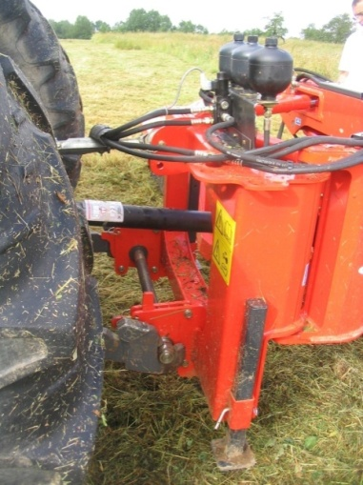
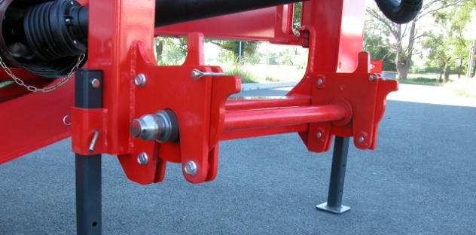
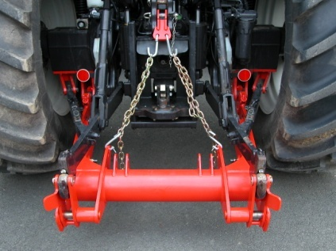
Hitching solutions
Semi-automatic hitch
Product points
The lower-point linkage is semi-automatic.
A hitch bar is used for this purpose.
Lugs pivot to lock the hitch automatically.
The bar comprises a set of category 2 or 3 swivel joints.
The Spring-Longer can be hitched to an optional Stabi-Link frame.
This frame is mounted on the original tractor linkage.
It takes just 5 minutes to fit or remove.
This frame is also compatible with the Pro-Longer hedge & grass cutter.

Slide 4
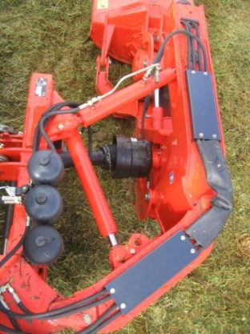
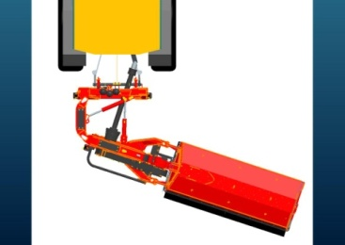
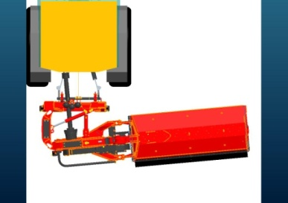
Safety
Forward and reverse hydraulic system
Product points
This hydraulic break-back safety function comes with automatic reset.
It is equipped with a double-rod cylinder to operate in forward and reverse motion.
The mower unit breaks back approximately 1300 mm in the forward direction and 350 mm in the reverse direction.
Note: On the front-mounted version, the forward and reverse break-back distances are switched.
The mower unit is reset automatically as a result of pressure exerted by the three nitrogen balls on the break-back cylinder.
The Spring-Longer is equipped as standard with a hydraulic safety function.
This type of safety offers the advantage of flexibility and responsiveness.
As a result, the structure is less subject to stress.
On an operational basis, this function is autonomous. The unit returns to its initial working position as soon as the obstacle has been avoided.

Slide 5
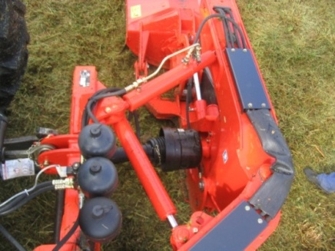
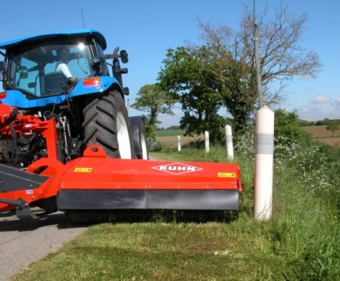
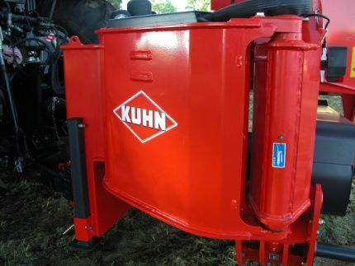
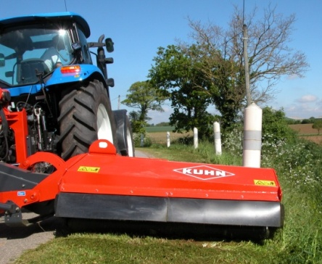
Offset
Horizontal pivot system
Product points
The hydraulic offset function offers 50% greater clearance than rival machines.
This means that not only can obstacles be avoided more easily, but also that the mower head can work behind or in front of the tractor wheel.
The tractor can therefore keep well within its own side of the road.
The horizontal offset function is hydraulically operated.
A hydraulic cylinder drives a pivot mounted on a 50 mm pin.
A generous 900 mm of offset is available.
This equipment is supplied as standard.
50%
greater
clearance
than rival machines

Slide 6
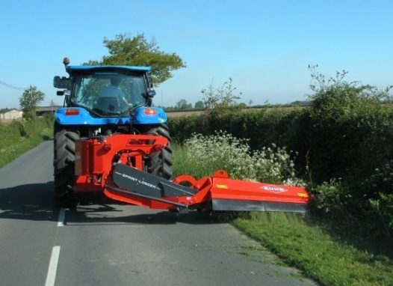
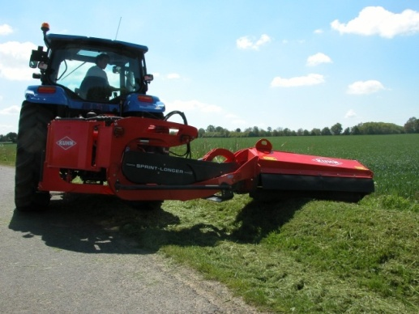
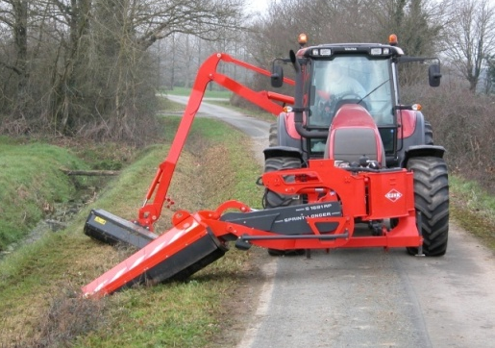
Offset
Vertical offset: an essential feature!
Product points
Few competitors offer this feature.
Numerous benefits:
Automatic compensation for humps and hollows when mowing flat.
Ability to mow above the road level on banks.
Easier to incline the mower unit in ditches.
Vertical offset raises the mower unit without having to adjust the tractor lift.
Vertical offset is provided by a hydraulic cylinder which drives a stay.
The offset distance is 600 mm.

Slide 7
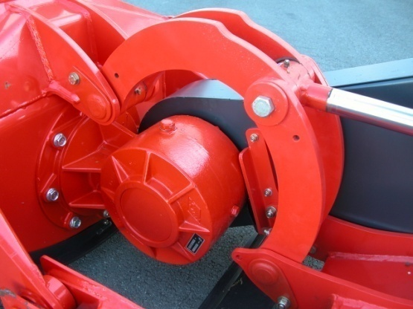
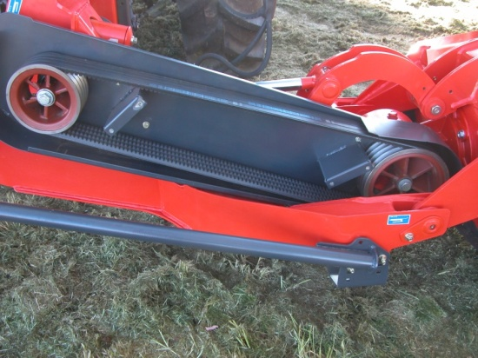
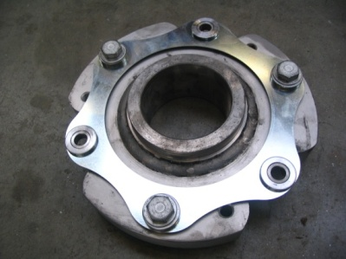
Drive
Simple, reliable and powerful!
Product points
This “3-in-1” gearbox combines three functions in a single component:
It provides the right-angle drive.
It supports the rotor.
It absorbs rotor stress and inertia through the flexible coupling.
The benefits are:
Fewer parts.
A more compact unit.
3-in-1 gearbox
The gearbox develops 120 hp at 1000 rpm.
Choice of 540 or 1000 rpm rotation by simply reversing the pulleys.
Tension is set automatically by a spring system.
Four cog-type V-belts connect the tractor to the gearbox.

Slide 8
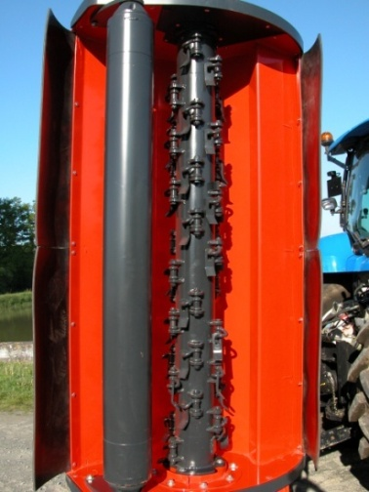
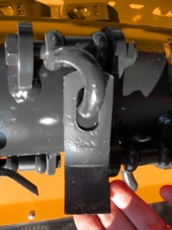
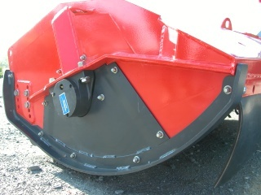
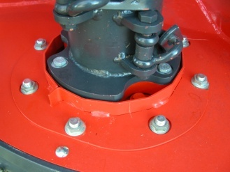
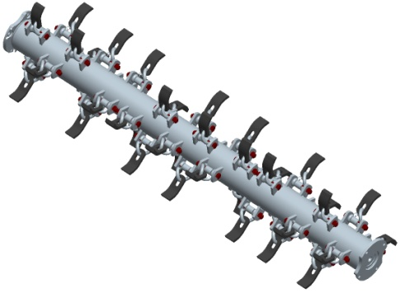
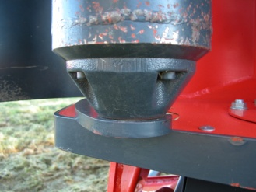
Flail head
Cutting width: 1.60 m / 2.00 m / 2.30 m
Product points
Self-aspirating housing shape combined with a rotor speed of 2530 rpm = cutting quality.
Effective cutting width: 1.60 m, 2,00 m or 2,30m
Rotor: 42 spoon flails for 1.60m / 54 spoon flails for 2,00m / 60 spoon flails for 2,30m
Wear shoes with rounded profile = smoother sliding action.
Integrated external half-bearing = protection.
Wire and twine protection baffles = protected bearings.
Front and rear flaps = projection guard.
Xtrem sensor roller (168 mm diameter) with removable ends as standard.
The rotor is symmetrical. This means that the two mounting flanges are identical.
The advantages are:
The leading direction of the knives and lugs can be reversed.
The rotor can be removed without touching the bearing.

Slide 9
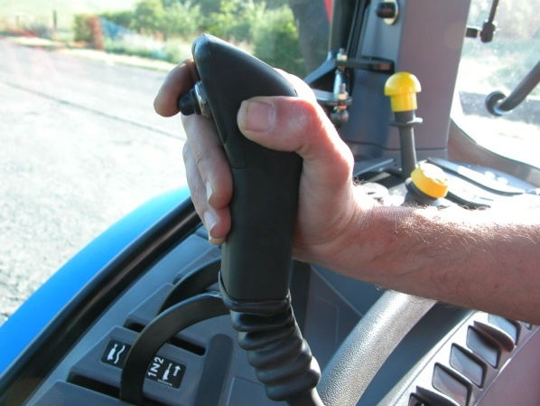
Controls
Circuit selector
Product points
The tractor must basically be equipped with one single-acting valve with float position, a double-acting valve and a free return.
The Spring-Longer receives a so-called circuit selector control as standard.
The circuit selector is connected to the tractor’s single-acting valve.
In turn, it controls vertical offset and flail head orientation.
Finally, the tractor’s double-acting valve controls horizontal offset.
The combination of two functions on the same joystick results in easier machine control.
2 functions,
1 joystick

Slide 10
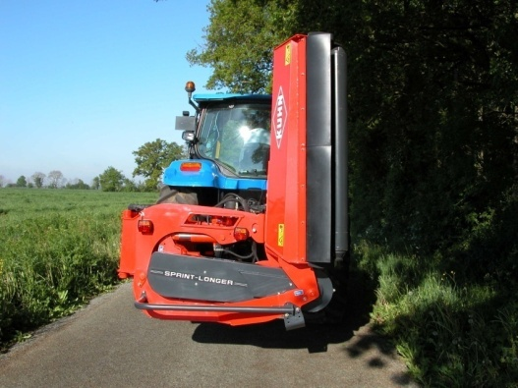
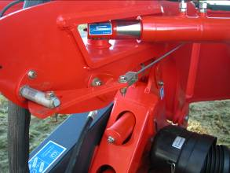
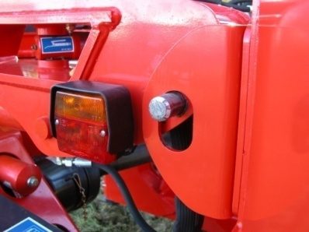
Transport position
Safety
Product points
The transport position is locked automatically (no need to get down from the tractor).
As explained opposite, a pin is activated by means of a cable. This cable is driven by the horizontal offset of the machine.
Consequently, if you offset the machine, then rock the head to the vertical position and retract the offset, the head will be locked.
Automatic
transport
lock
The Spring-Longer is less than 2 m wide in the transport position. It therefore remains within the tractor outline.
For maximum safety, the mower unit is mechanically locked.
The locking system is based on a pin indexed to a cable.

Slide 11
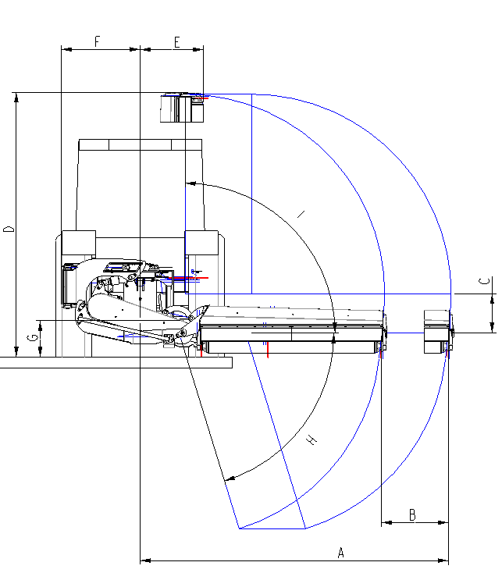
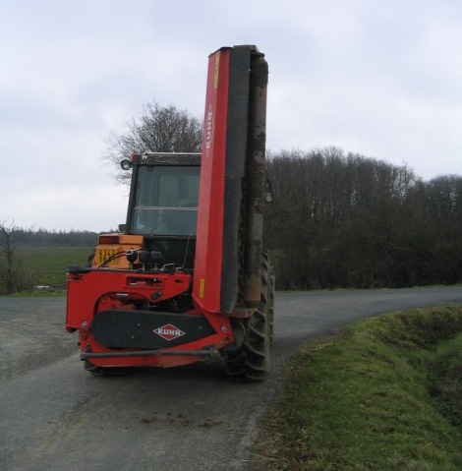
Kinematics
SPECIFICATIONS | S 1680 RP | S 2080 RP | S 2380 RP
Position of the mower unit | Side rear
Horizontal offset A | 3.50 m | 3.90 m | 4.20 m
Horizontal displacement B | 0.90 m
Horizontal displacement mode | Pivot
Mower unit safety | Hydraulic break-back in forward/reverse with auto return
Vertical displacement C | 0.60 m | 0.60 m | 0.60 m
Vertical displacement mode | stay | stay | stay
Transport height with 0.5 m ground clearance | 2.60 m | 3.00 m | 3.30 m
Transport width F | 1.91 m
Max. ditch angle | 70°
Max. bank angle | 90°
Machine weight | 1285 kg | 1365 kg | 1425 kg
Tractor power | 70 hp | 75 hp | 80 hp
Tractor weight | 3500 kg | 3500 kg | 3500 kg

Slide 12
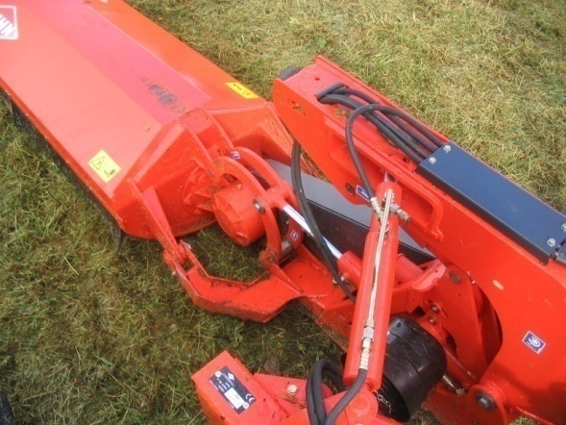
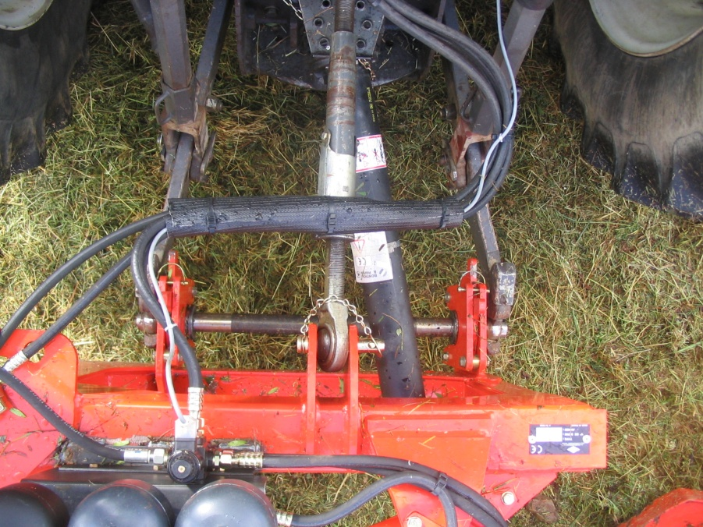
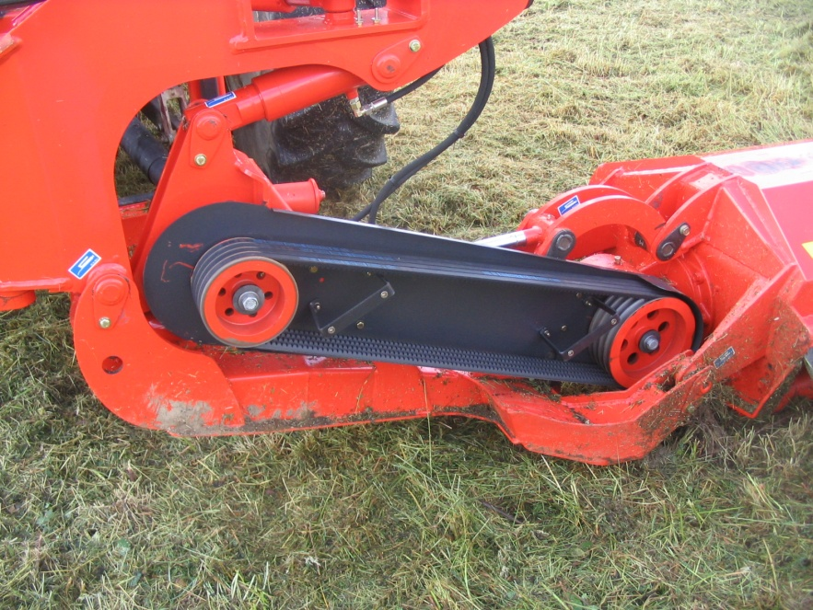
Drive
SPECIFICATIONS | S 1680 RP | S 2080 RP | S 2380 RP
PTO speed | 540 min⁻¹ at 90 hp or 1000 min⁻¹ at 120 hp by reversing the two pulleys
Universal joint | Without free-wheel clutch
Belt | Four V-belts
Gearbox | Helical bevel gears

Slide 13
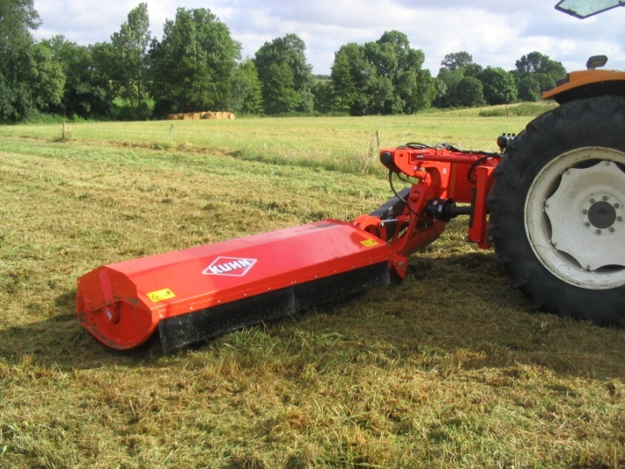
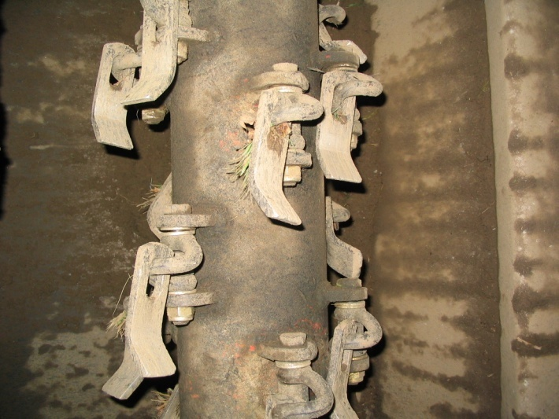
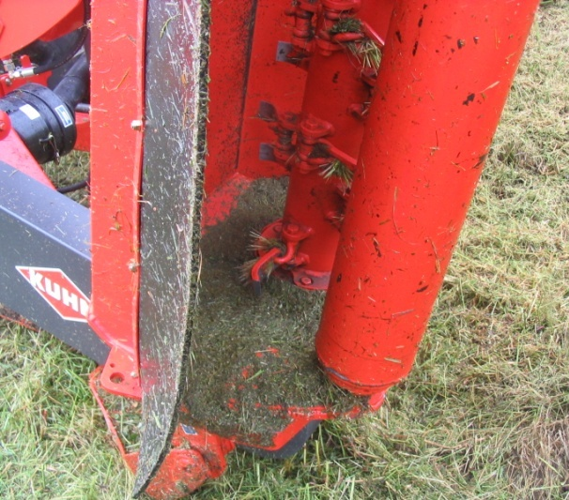
Mower unit
SPECIFICATIONS | S 1680 RP | S 2080 RP | S 2380 RP
Cutting width | 1.60 m | 2.00 m | 2.30 m
Cutting height | 4 settings: 40 / 70 / 100 / 130 mm
Rotor diameter with knives | 460 mm
Rotor speed | 2,530 min⁻¹
Type of flails | spoon
Number of flails | 42 | 54 | 60
Shackle diameter | 14 mm
Shackle screw diameter | 14 mm
Sensor roller diameter | 170 mm
Projection guard | 90°

Slide 14
SPRING-LONGER

